Slide 1
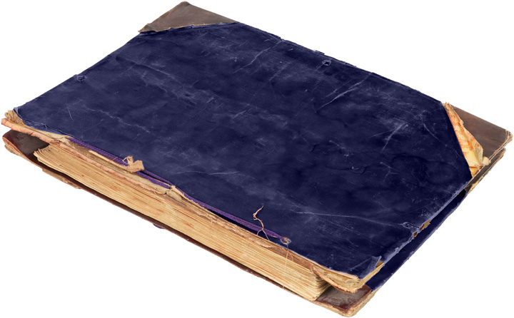
How did William T. Sherman’s war strategies impact Georgia and the outcome of the Civil War?

Slide 2

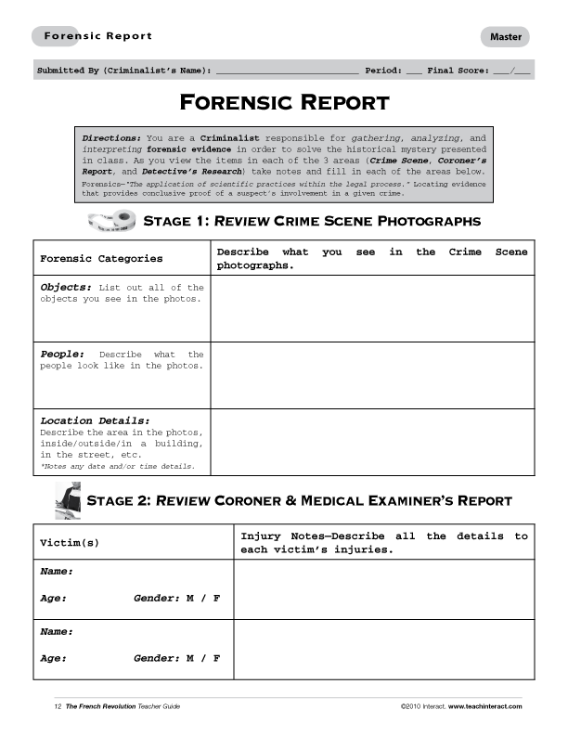
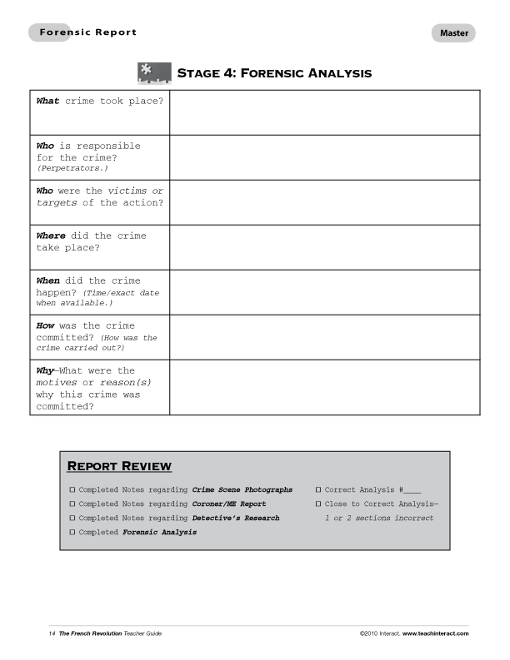
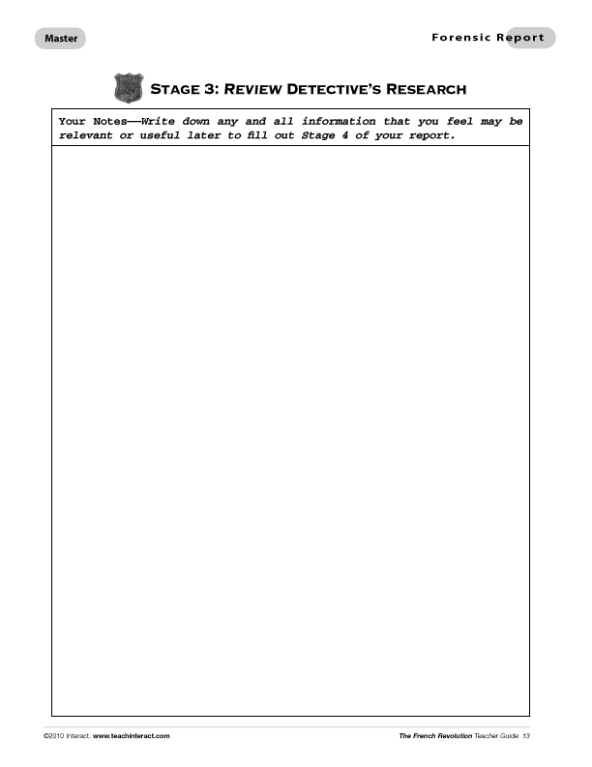
In order to solve a History Mystery you will need
to have a Forensic Report, a Mystery File,
a pen/pencil, and a open mind.
Before you begin, let’s take a moment to
review all the sections of the Forensic Report
so that you are familiar with all the areas of the file
and what you need to do.
Keep in mind that as you review the
items in the file, you are acting as if
you are a Criminalist responsible
for gathering, analyzing, and
interpreting forensic evidence.
These actions are key to helping
you solve the historical mystery
presented in class. Good Luck!

Slide 3
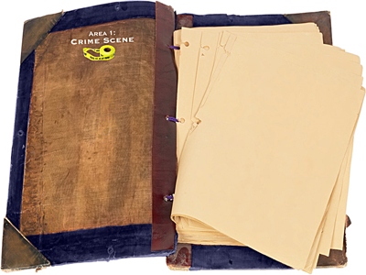

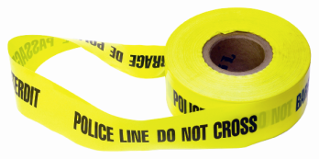
As you view the items in each of the three areas (Crime Scene, Coroner’s Report, and Detective’s Research) take notes and fill in each of the areas on the Forensic Report.
Pay close attention to which office
is reporting information and match
the photos on your file with the photo on your report when you are writing in your information.
For example, if you see the symbol for the Crime Scene office on the top of the file page, you may use that information
to answer the questions about the Crime Scene in your Forensics Report.

Slide 4


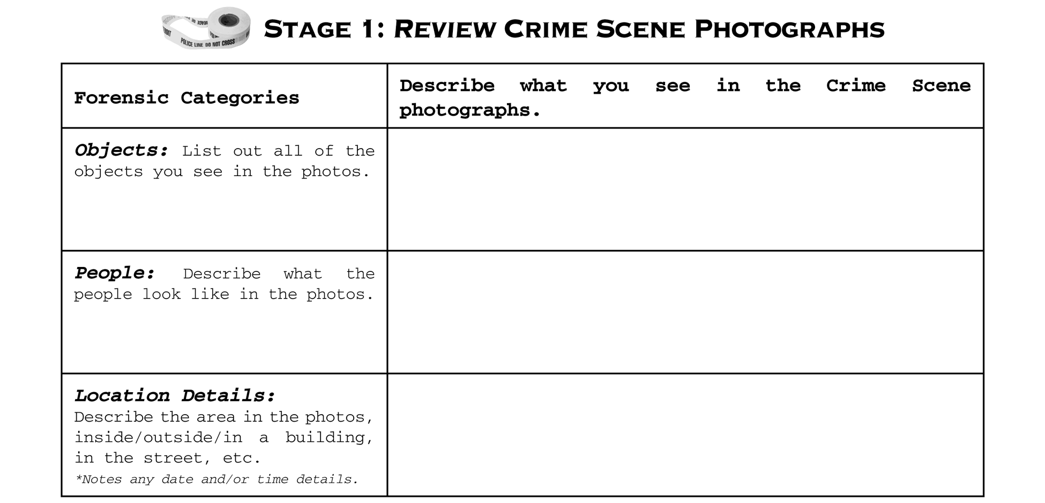
If you are looking at notes and photos about the Crime Scene, they will be marked with a photo of caution tape.
Fill in your report sheet for this section by writing in notes about all the objects, people, and location details that you see.

Slide 5

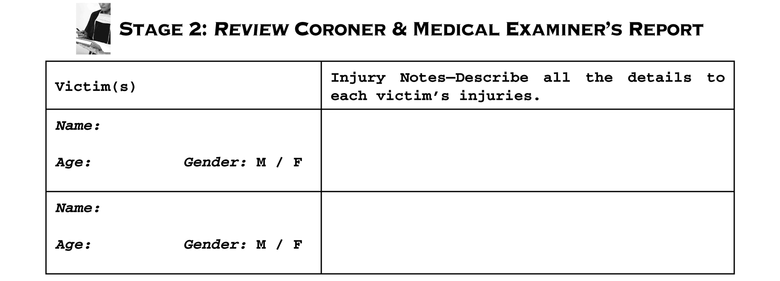
If you are looking at documents and photos with specific information about the victim’s body, then these are part of the Coroner’s Report and they will be marked with a photo of a coroner writing a report.
Fill in your report sheet for this section by writing in specific information about each recovered body. Note the person’s name, gender, age and injury information.

Slide 6
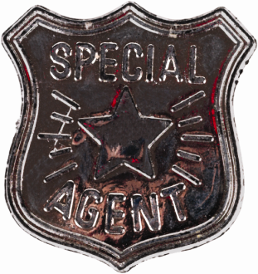
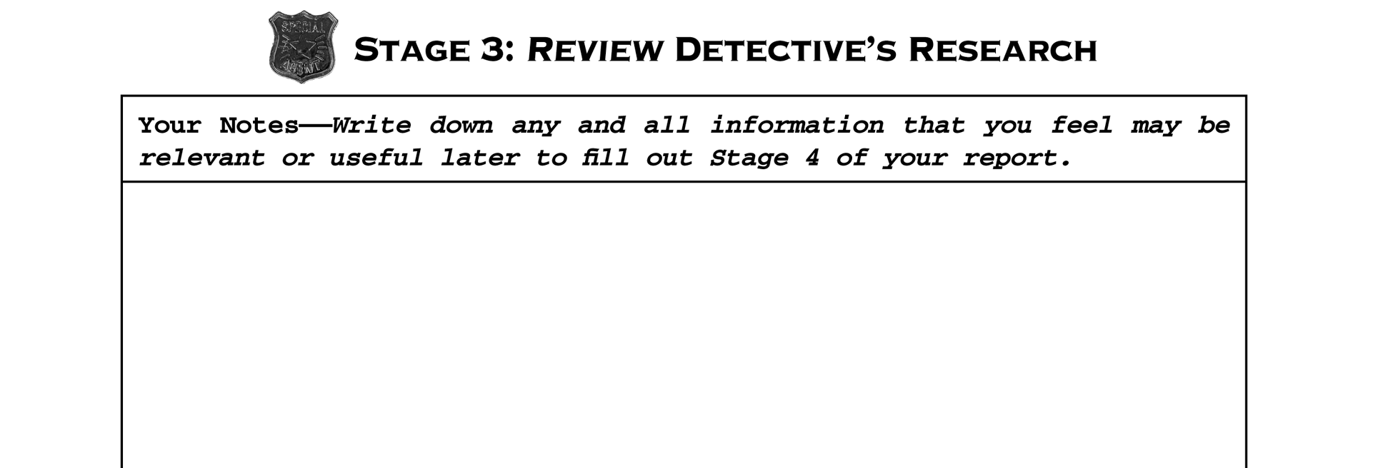
And if you are looking at notes, documents, and/or images from the Detective’s Research they will be marked with a photo of an investigator’s badge.
Fill in your report sheet for this section by writing down any and all information that you feel may
be useful to you later when you fill out Stage 4.

Slide 7
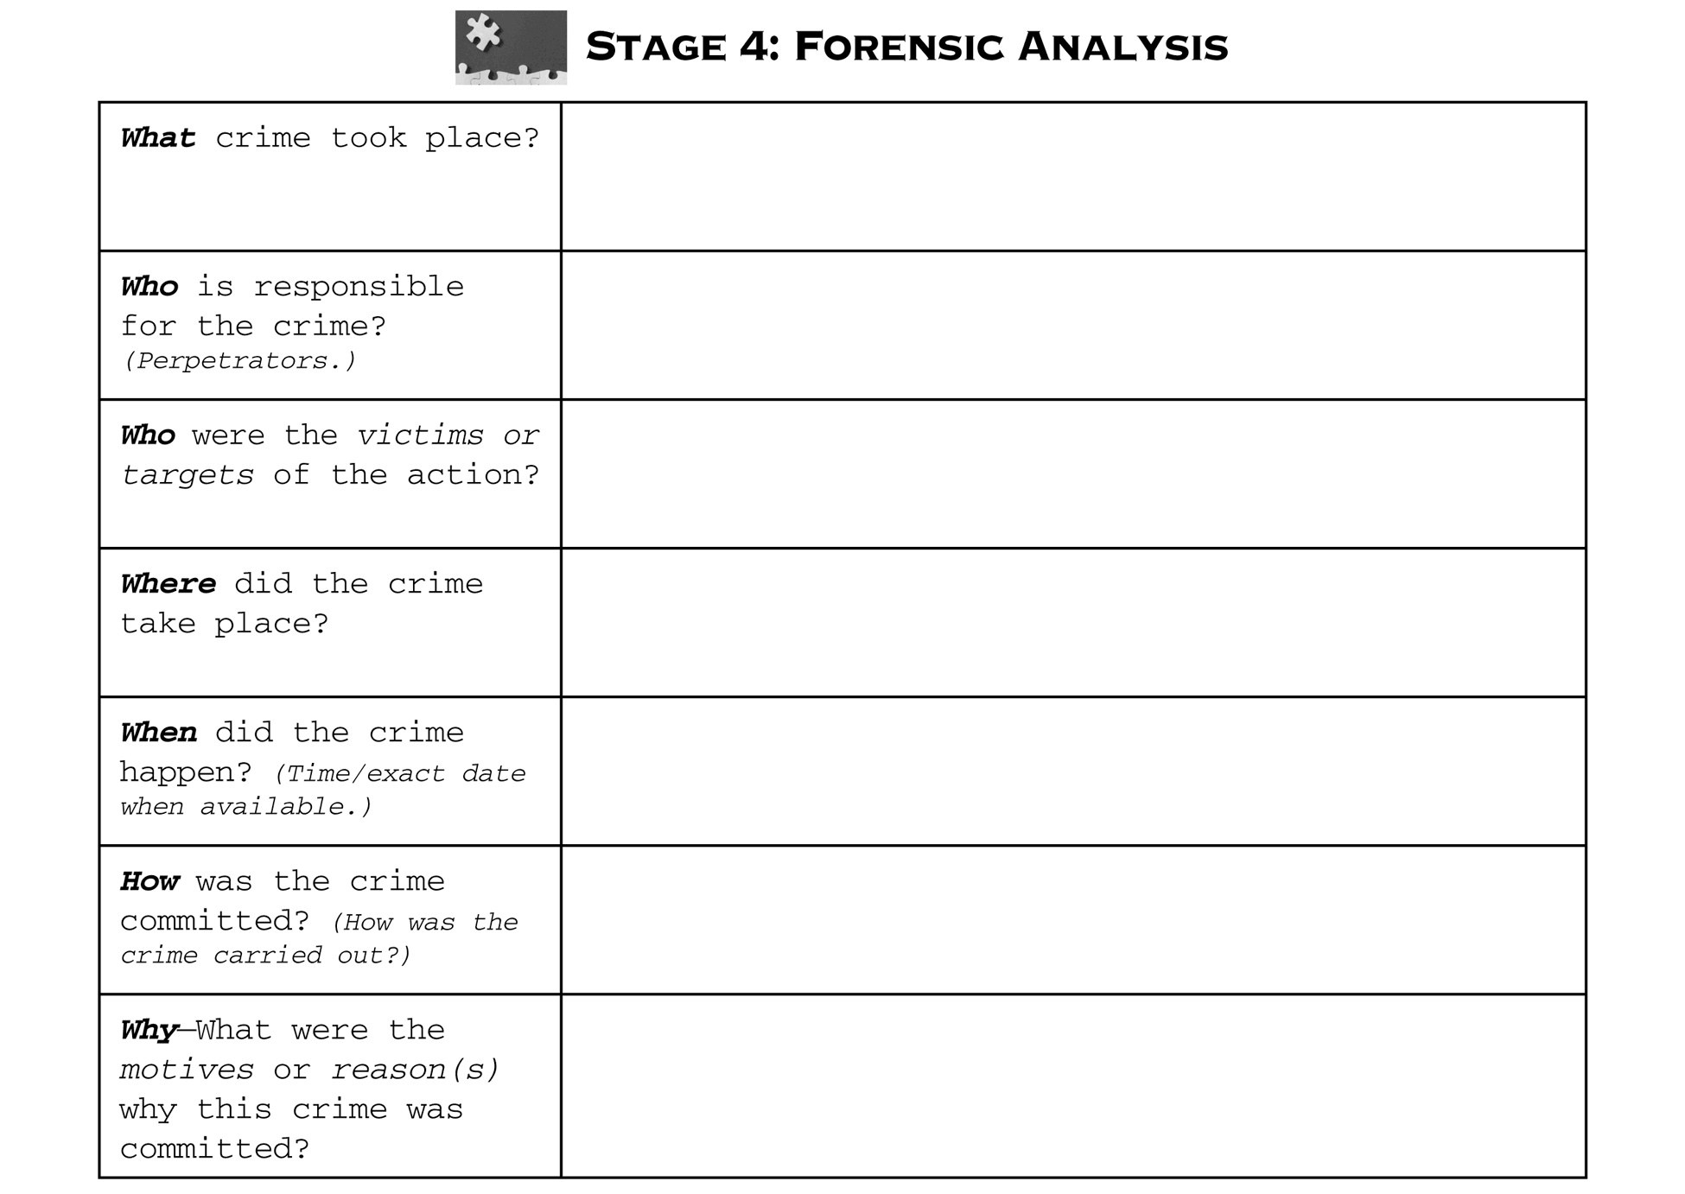
Once you have filled in Stages 1–3 you then use this information to come up with a theory of what event you think took place and why.
Read through carefully and answer each question in Stage 4: Forensic Analysis.

Slide 8
What do I do when I am done?
Finally, once the entire class has turned
in their reports, you will read a Mystery Solved: Press Release that will tell
you the background behind the case
you just finished reviewing.

Slide 9






Slide 10

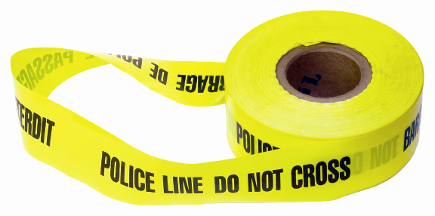

Slide 11
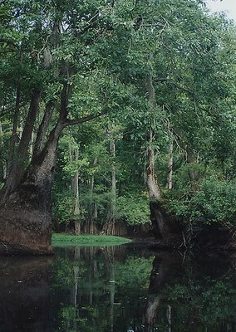

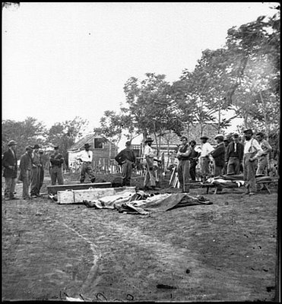
Area 1: Crime Scene
December 9, 1864

Slide 12
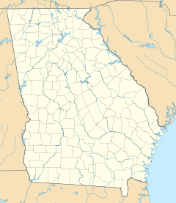
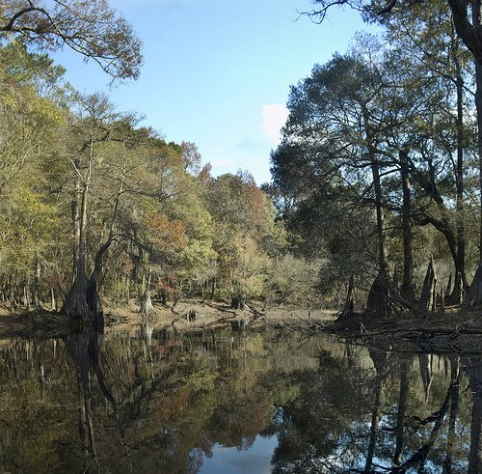
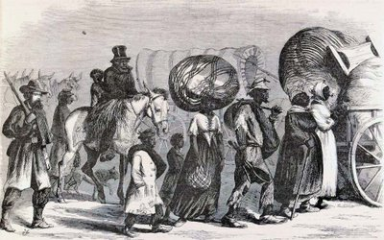
Area 1: Crime Scene
Ebenezer Creek, GA

Slide 13



Slide 14

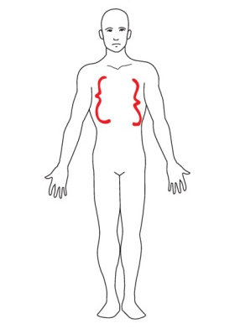
Sex: Male & Female Race: Black
Ages: Males are older, at least in 50s; females and children’s ages are unknown
External Injuries
Some show frostbite injuries from exposure. 36 bodies show gun-shot wounds. 7 bodies show stab-wounds similar to bayonet. 14 bodies have severe head trauma.
Internal Injuries: drowning victims found with lungs full of water; head trauma victims show brain swelling and cracked skulls.
Area 2: Coroner’s Report
Victims: Approximately 95 dead men, women, and children
Description of Corpses
Victims found in and near creek. Clothing was worn and dirty, many without shoes. Personal belongings found with some victims.
Head trauma
Lung damage
Gun and stab wounds

Slide 15



Slide 16


limited in many ways it basically meant that all slaves would be freed as the Union army captured Confederate territory.
After the South’s defeat at Gettysburg, the Union went on a major offensive. The Confederate army could not do anything but retreat and defend what little they had left. The Union army’s main goal in the western theatre of the war: capture Georgia and take control of the railroad lines.
Georgia was an important railroad and industrial center for the Confederacy. The Union knew that destroying the railroad lines in Georgia and capturing major industries would cripple the Confederate army. Attempts had been made to do this, but with little or no success.
After the Union victory at Antietam, President Lincoln issued the Emancipation Proclamation. While the Emancipation Proclamation was

Slide 17
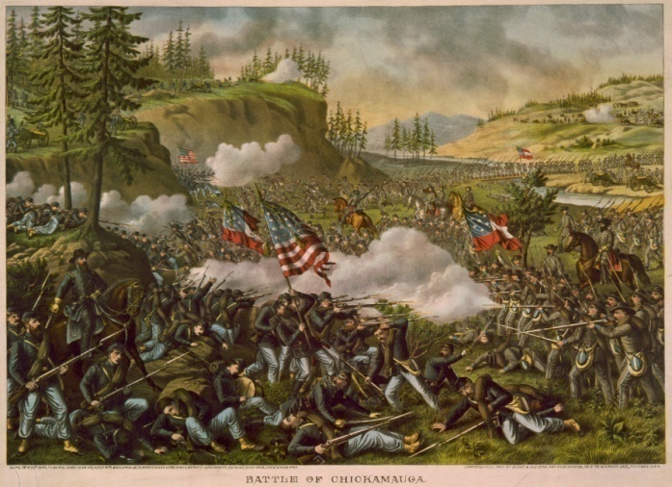
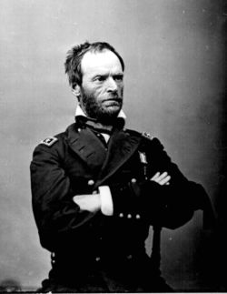
At the Battle of Chickamauga in north Georgia, fought from Sept. 18-20, 1863, the Union army was defeated. This battle was the second bloodiest battle of the Civil War with over 34,000 casualties. The Union army retreated into Chattanooga where they defeated the Confederate army. There, the newly selected General William T. Sherman planned his invasion of Georgia.

Slide 18
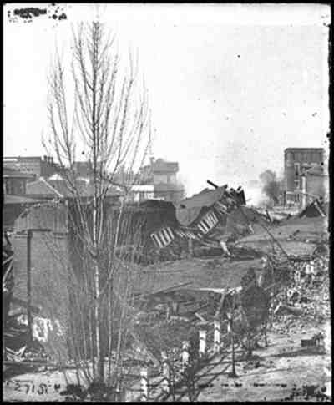
General Sherman bombarded the city with cannon for over a month and left the city in ruins. Sherman’s victory in seizing Atlanta helped President Lincoln secure a re-election because it showed the Union was winning the war. While in Atlanta, Sherman developed his plan to march to Savannah; his infamous “March to the Sea”.
General Sherman advanced into Georgia in the Spring of 1864 headed for Atlanta, a major railroad and industrial center of the state. Sherman continuously outflanked his enemy, engaging in several small battles rather than large battles, along his route to Atlanta, including a battle at Kennesaw Mountain.
Though Sherman suffered several losses, his flanking strategy worked and he reached Atlanta in September 1864.

Slide 19
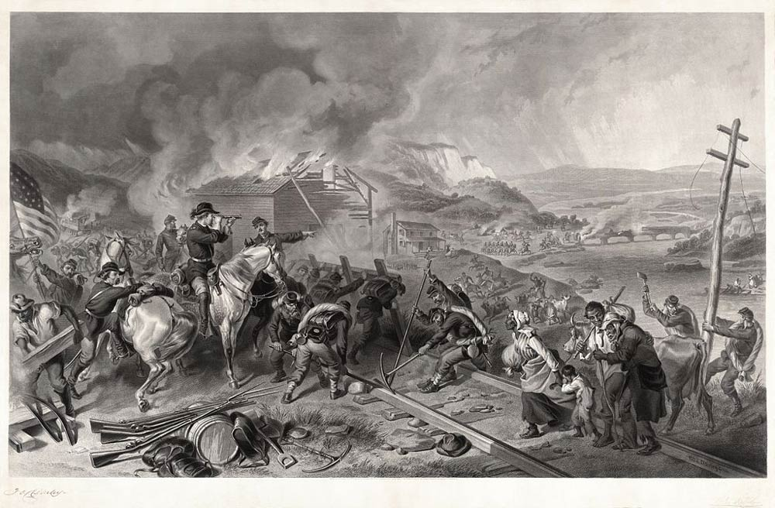
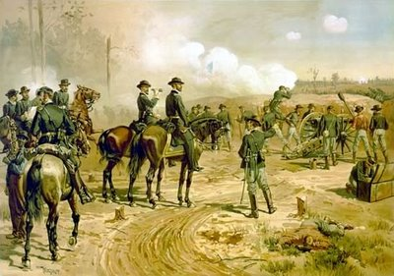
From November 1864 to December 21, 1864 Sherman’s army lived off the land and freed slaves as they marched to seize Savannah.
For his “march to the sea” General Sherman developed a “total war” strategy. Sherman wanted to end the war quickly and punish the South for starting the war. His total war strategy called for Union troops to wage war against everything that could be of use to the enemy. This meant destroying civilian homes, farms, businesses, and seizing food, supplies, and property while on his 60-mile wide path of destruction to Savannah.

Slide 20
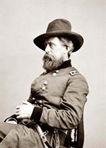
Davis was known for his ill-temper. One report states he shot and killed a commanding officer because of an insult he suffered. Along the march, Davis grew more and more irritated as the refugees contributed to the food-shortage problem and began slowing down his march. This became a particular concern when Davis learned the Confederate Commander Wheeler was close behind him.
Throughout Sherman’s March to the Sea, thousands of freed slaves attached themselves to the Union army’s various infantry columns. Many were able-bodied black men who were willing to supply labor clearing roads, carrying supplies, serving as cooks and other jobs. However, Brigadier General Jefferson C. Davis of the Union army began to grow irritated at the few thousand other black refugees who could not provide a service to the Union army because of their age or gender.

Slide 21
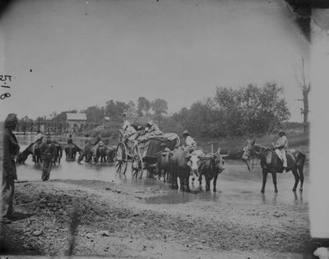
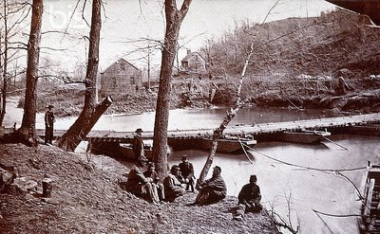
On December 9, 1864 Brigadier General Jefferson C. Davis crossed the banks of Ebenezer Creek just as Confederate Commander Wheeler’s cavalry approached and began firing on the Union lines. By the end of the day, hundreds of the African-American refugees that had been following the Union were dead.

Slide 22

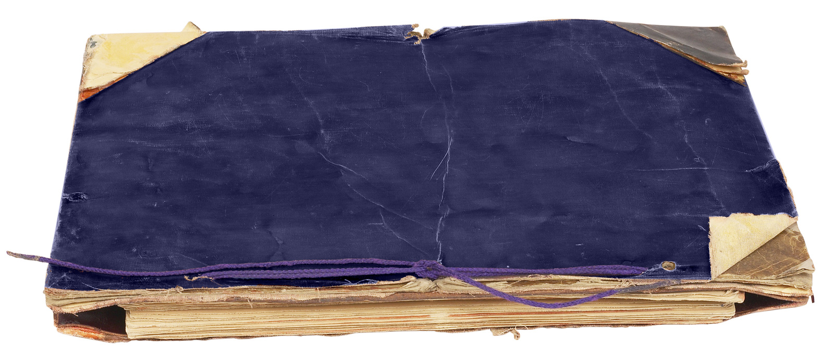

Slide 23
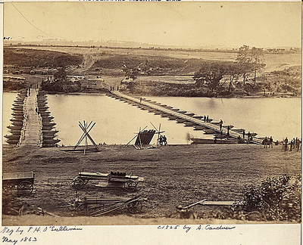
MYSTERY SOLVED!
Throughout Sherman’s march, many slaves were freed. With nowhere else to go, they followed Sherman. However, it became harder and harder for the Union army to move quickly and care for all of the freedmen.
Brigadier General Davis devised a plan to rid his line of the refugees when he reached Ebenezer Creek and realized his men needed to cross the pontoon bridge quickly as the Confederates were approaching.
Davis instructed the freedmen to wait along the bank of the creek until all of his men crossed. Then, they would be allowed to cross the pontoon bridge.

Slide 24
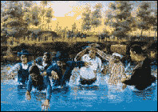
However, once the Union army had crossed, Davis ordered the pontoon bridge destroyed, leaving the freedmen on the other side to face the Confederate army.
Knowing the fate that awaited them, many decided to jump in the creek and attempt to swim across. Many old men, women, and children drowned trying to swim across the creek. Others decided to stay on the bank and fight the Confederate soldiers. They were quickly cut down with bayonets and rifles.
Those that survived were placed
back in slavery until the end of the war and the ratification of the 13th Amendment.

Slide 25
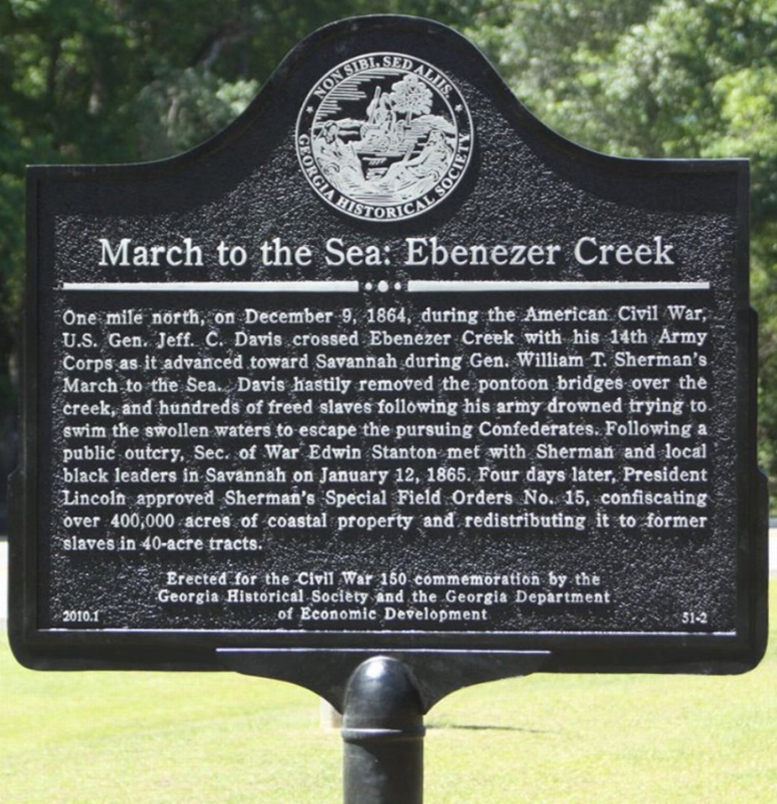
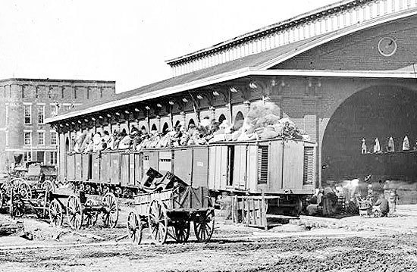
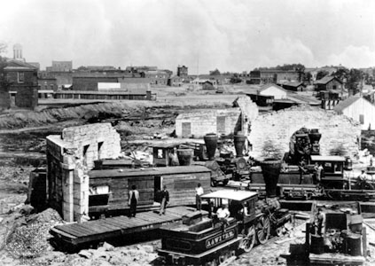
Davis’ actions were supported by General Sherman as a “military necessity”. Davis went on to be named General, while Sherman was hailed as a war hero and eventually became General-in-Chief of the U.S. Army.

Slide 26
Writing Task
Write a one-page persuasive essay.
  Is General William T. Sherman a hero or a villain? Support your opinion with facts drawn from class.

